Slide 1
Java Language Constructs

Slide 2
AGENDA
1
Java Basics
2
Java Naming Conventions
3
Java Variables
2
4
Java Data Types
2
5
Control Statements

Slide 3
Java Basics

Slide 4
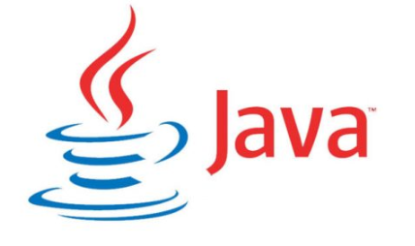
What is Java
Java is one of the most popular and widely used programming language and platform. A platform is an environment that helps to develop and run programs written in any programming language.

Slide 5
Features/Benefits of Java Programming Language
Java is easy to learn
Java is object-oriented programming language
Java is platform independent
Excellent documentation support javadocs
Great collections of open sources libraries

Slide 6
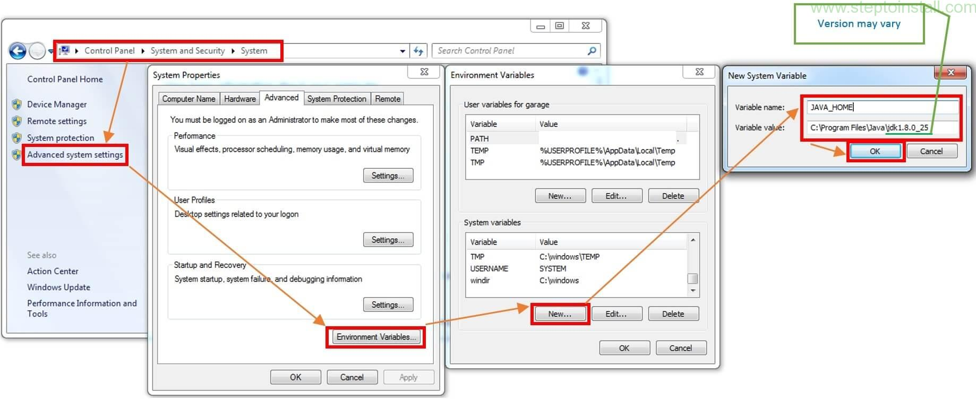
Setting JAVA_HOME path

Slide 7
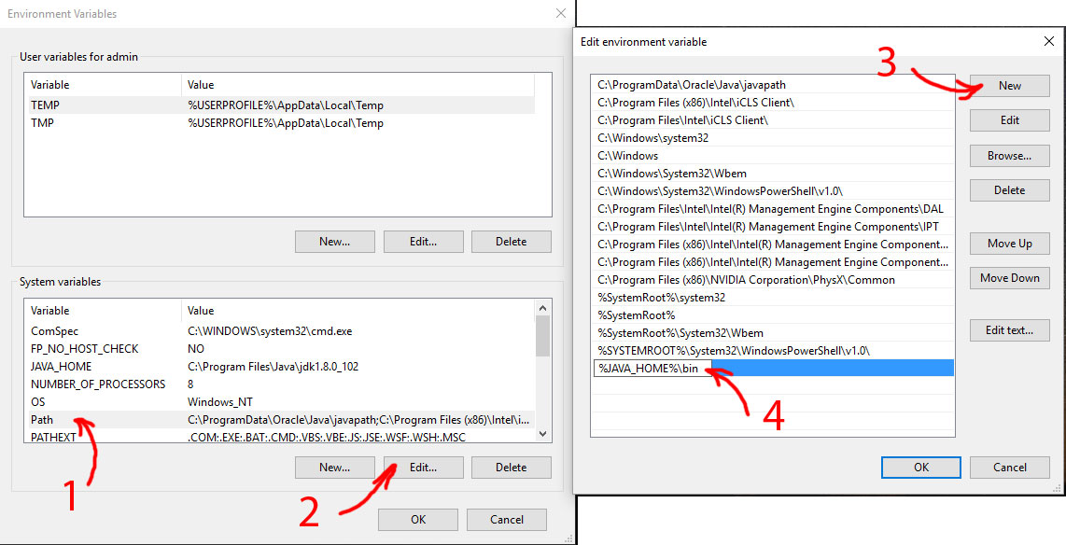
Adding JAVA_HOME to Path

Slide 8
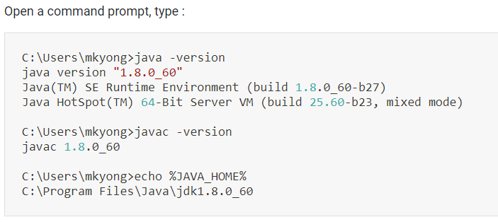
Test

Slide 9
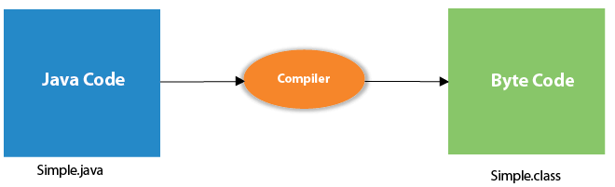
What happens at compile time?
At compile time, java file is compiled by Java Compiler (It does not interact with OS) and converts the java code into bytecode.

Slide 10
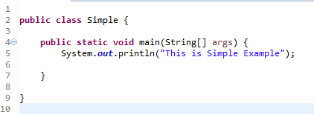
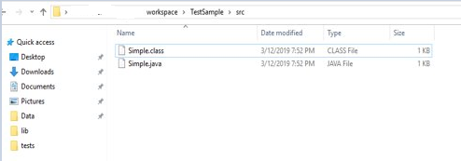
Simple Java Examples
To compile: javac Sample.java
<Path to workspace>javac Simple.java
To execute: java Sample
After compiling Sample Class

Slide 11
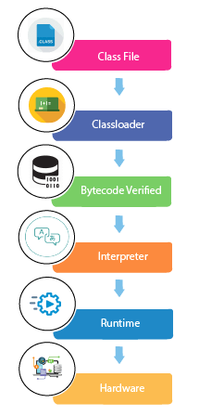
What happens at Run time?
JVM: virtual machine residing in the computer that provides an environment for the code to get executed. Java Runtime Environment or JRE is an implementation of the JVM. In order to execute the code, an execution engine is used
Class Loader: is the subsystem of JVM that is used to load class files
ByteCode Verified: checks the code fragments for illegal code that can violate access right to objects.
Interpreter: read bytecode stream then execute the instructions and creates an instance of the JVM that allows the Java program to be executed natively on the underlying machine.

Slide 12
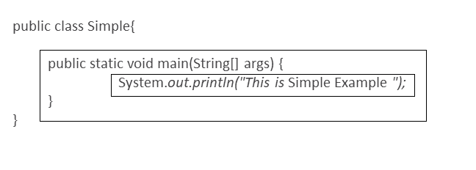
Sample Java Application
Class name
main method
body
Statement

Slide 13
Parameters used in Sample Java Application
class keyword is used to declare a class in java.
public keyword is an access modifier which represents visibility. It means it is visible to all.
static is a keyword. If we declare any method as static, it is known as the static method. The core advantage of the static method is that there is no need to create an object to invoke the static method. The main method is executed by the JVM, so it doesn't require to create an object to invoke the main method. So it saves memory.
void is the return type of the method. It means it doesn't return any value.

Slide 14
Parameters used in Sample Java Application
main represents the starting point of the program.
String[] args is used for command line argument. We will learn it later.
System is a class from the java.lang package.
out is a class variable of type PrintStream declared in the System class.
println is a method of the PrintStream class.
class System {
public static PrintStream out;
}
class PrintStream {
public void println ...
}

Slide 15
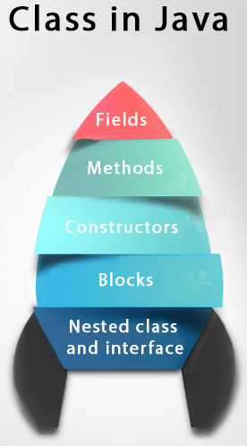
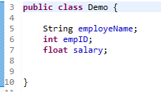
Class
What is a Class?
A class is a template for defining objects. It specifies the names and types of variables that can exist in an object, as well as "methods"--procedures for operating on those variables.

Slide 16
Object
What is an Object ?
An instance to a class is called Object.
We can create object in two steps.
Create the reference variable
Demo obj;
Allocating the memory allocation of object using new keyword
obj = new Demo();
obj.employeName
obj.empID
obj.salary
obj
Demo obj = new Demo();
1000
1000

Slide 17
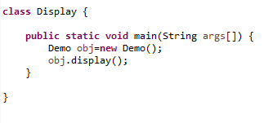
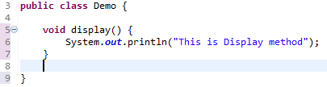
Methods
Defining functions in a class definition are called methods.
Procedures- methods that access no arguments and returns no value
Mutators- methods that accept arguments and returns no values
Accessors- methods that accept and returns values

Slide 18
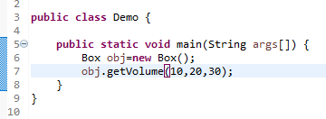
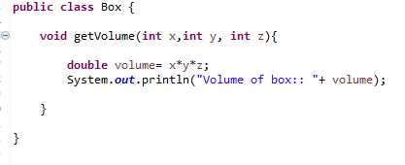
Methods passing arguments and returns no value
Output: Volume of box:: 6000.0

Slide 19
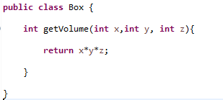
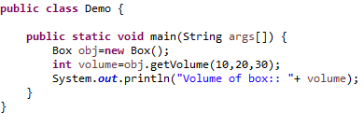
Methods passing arguments and returns value
Output: Volume of box:: 6000.0

Slide 20
Java Variables

Slide 21
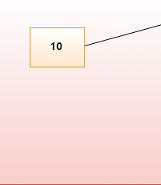
Java Variables
Variable is name of reserved area allocated in memory. In other words, it is a name of memory location. It is a combination of "vary + able" that means its value can be changed.
RAM
Reserved Area

Slide 22
Types of Variables
There are 3 types of variable
Local variable
Instance variable
Static variable
Local variable
A variable declared inside the body of the method is called local variable.
class A{
void method(){
int n=90; //Local variable
}
}//end of class
In Java, the scope of a local variable is the body of the method in which it is declared. In other words, the variable is visible in the body of the method where its declaration appears, but it is not visible on the outside the method.

Slide 23
Types of Variables
Instance variable:
A variable which is declared inside a class and outside all the methods and blocks is an instance variable. The general scope of an instance variable is throughout the class except in static methods. The lifetime of an instance variable is until the object stays in memory.
class A{
int data=50;//instance variable
void method()
{
int n=90;//local variable
}
}//end of class

Slide 24
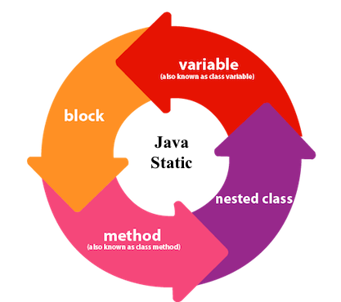
Static Keyword
The static keyword in Java is used for memory management mainly.
Static keyword can be applied for variables, methods, blocks and nested class.
The static keyword belongs to the class than an instance of the class.
Java static variable:
static String name =“john";//static variable aka class variable
Java static method:
public static void main(String args[])
Java static block:
static { }
Java Inner Class:
Class Sample{
static InnerClass{
}
}

Slide 25
Types of Variables
Static variable:
Static variables are stored in the static memory. It is rare to use static variables other than declared final and used as either public or private constants. Static variables are created when the program starts and destroyed when the program stops.
Visibility is similar to instance variables. However, most static variables are declared public since they must be available for users of the class.
Static variables can be accessed by calling with the class name ClassName.VariableName.
class A{
static int data=50;//static variable
void method()
{
int n=90;//local variable
}
}//end of class

Slide 26
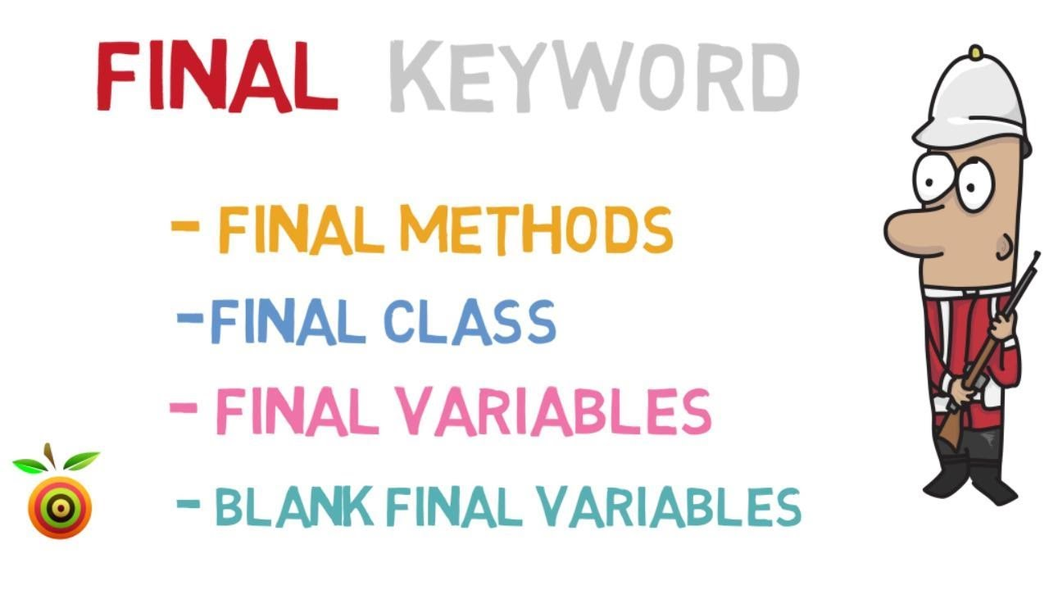
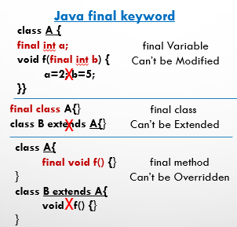
Final
Notes:
Show examples: BitDemo.java

Slide 27
Java Naming Conventions

Slide 28
Java Naming conventions
Java naming convention is a rule to follow as you decide what to name your identifiers such as class, package, variable, constant, method, etc.
Advantage of naming conventions
Java naming conventions, you make your code easier to read for yourself and other programmers. Readability of Java program is very important. It indicates that less time is spent to figure out what the code does.
The following are the key rules that must be followed by every identifier:
The name must not contain any white spaces.
The name should not start with special characters like & (ampersand), $ (dollar), _ (underscore).

Slide 29
Java Naming conventions
Class
It should start with the uppercase letter.
Use appropriate words, instead of acronyms.
Example:
public class Employee
{
//code snippet
}

Slide 30
Java Naming conventions
Method
It should start with lowercase letter.
It should be a verb such as main(), print(), println().
If the name contains multiple words, start it with a lowercase letter followed by an uppercase letter such as actionPerformed().
Example :
class Employee
{
//method
void draw()
{
//code snippet
}
}

Slide 31
Java Naming conventions
Variable
It should start with a lowercase letter such as id, name.
It should not start with the special characters like & (ampersand), $ (dollar), _ (underscore).
If the name contains multiple words, start it with the lowercase letter followed by an uppercase letter such as firstName, lastName.
Avoid using one-character variables such as x, y, z
Example :
class Employee
{
//variable
int id;
//code snippet
}

Slide 32
Java Data Types

Slide 33
Data Types
There are two types of data types in Java
Primitive data types:
The primitive data types include boolean, char, byte, short, int, long, float and double.
Primitive types are predefined (already defined) in Java.
A primitive data type specifies the size and type of variable values, and it has no additional methods.
A primitive type has always a value
A primitive type starts with a lowercase letter
The size of a primitive type depends on the data type
Non-primitive data types:
The non-primitive data types include Classes, Interfaces, and Arrays.
Non-primitive types are created by the programmer and is not defined by Java
Non-primitive types can be null
Non-primitive types starts with an uppercase letter.
Non-primitive types have all the same size.

Slide 34
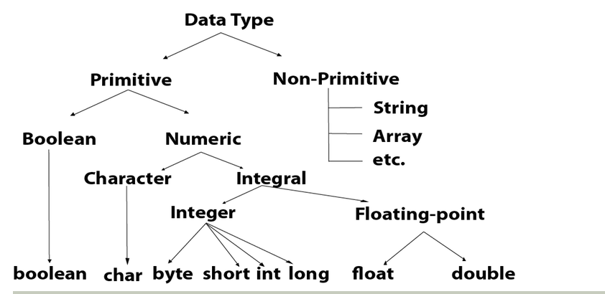
Data Types

Slide 35
Data Types
Boolean Data Type
The Boolean data type is used to store only two possible values: true and false.
Example: Boolean one = false
Int Data Type
The int data type is generally used as a default data type for integral values.
Example: int a = 100000
Long Data Type
The long data type is a 64-bit two's complement integer.
Example: long a = 100000L

Slide 36
Data Types
Double Data Type
The double data type is a double-precision 64-bit IEEE 754 floating point.
Example: double d1 = 12.3
Char Data Type
The char data type is used to store characters.
Example: char letterA = 'A'

Slide 37
Control Statements

Slide 38
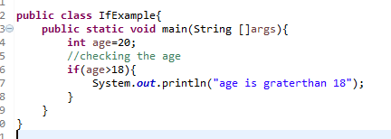
Java If-else Statement
The Java if statement is used to test the condition. It checks boolean condition: true or false.
if statement
if-else statement
if-else-if ladder
nested if statement
Java if Statement
The Java if statement tests the condition. It executes the if block if condition is true.
Syntax: if(condition){ Example:
//code to be executed
}

Slide 39
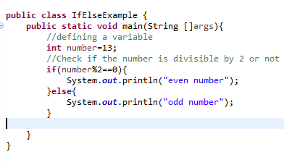
Java If-else Statement
Java if-else Statement:
The Java if-else statement also tests the condition. It executes the if block if condition is true otherwise else block is executed.
Syntax: Example:
if(condition){
//code if condition is true
}else{
//code if condition is false
}

Slide 40
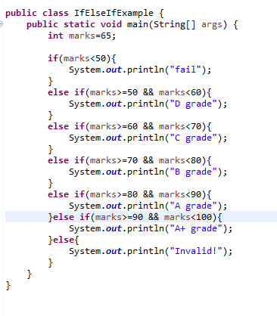


Java if-else-if ladder Statement
The if-else-if ladder statement executes one condition from multiple statements.
Syntax: if(condition1){
//code to be executed if condition1 is true
}else if(condition2){
//code to be executed if condition2 is true
} else if(condition3){
//code to be executed if condition3 is true
} ...
else{
//code to be executed if all the conditions are false
}
Java if-else-if ladder Statement

Slide 41
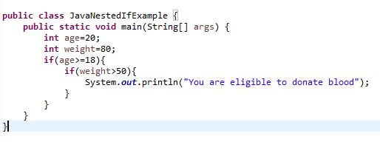
Java Nested if statement
The nested if statement represents the if block within another if block.
Syntax: if(condition){
//code to be executed
if(condition){
//code to be executed
}
}
Example:
Example:

Slide 42
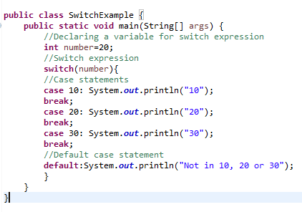
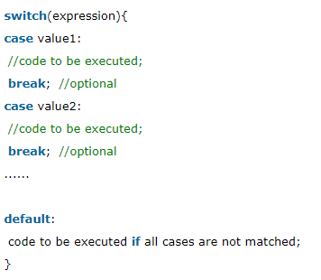
Switch Statement
The Java switch statement executes one statement from multiple conditions. It is like if-else-if ladder statement.
Syntax:
Output: 20

Slide 43
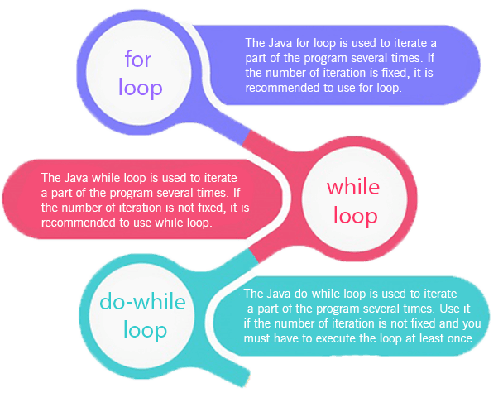
Loops
Loops
There are three types of loops in java.
for loop
while loop
do-while loop

Slide 44
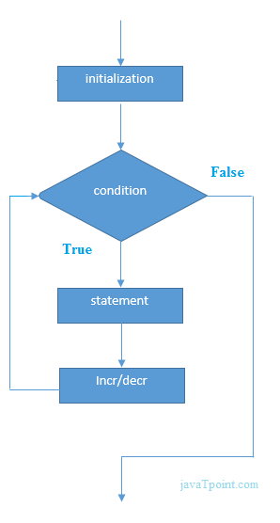
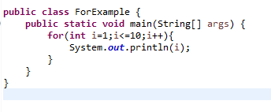

For Loop
Syntax: for(initialization;condition;incr/decr){
//statement or code to be executed
}
Example:
Output:

Slide 45
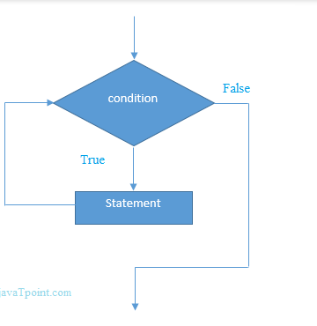
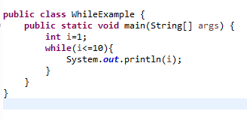
While Loop
The Java while loop is used to iterate a part of the program several times. If the number of iteration is not fixed, it is recommended to use while loop.
Syntax: while(condition){
//code to be executed
}
Example:
Output:

Slide 46
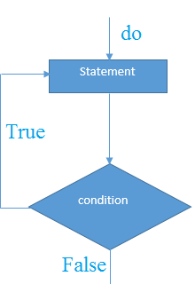
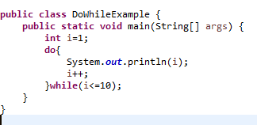
Do While Loop
The Java do-while loop is executed at least once because condition is checked after loop body.
Syntax: do{
//code to be executed
}while(condition);
Example:
Output:

Slide 47
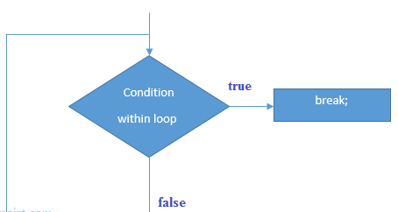
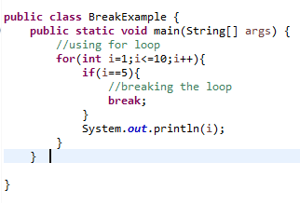
Break
The Java break is used to break loop or switch statement. It breaks the current flow of the program at specified condition. In case of inner loop, it breaks only inner loop.
We can use Java break statement in all types of loops such as for loop, while loop and do-while loop.
Syntax: Example:
jump-statement;
break;
Output:

Slide 48
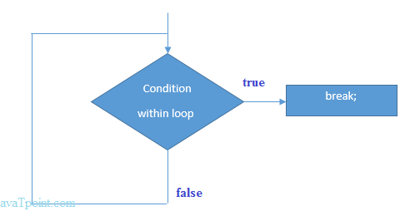
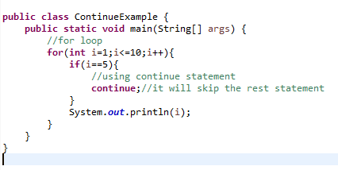
Continue
The Java continue statement is used to continue the loop.
Syntax:
jump-statement;
continue;
Example:
Output:

Slide 49
References
How to set JAVA_HOME path
https://docs.oracle.com/cd/E19182-01/820-7851/inst_cli_jdk_javahome_t/
https://mkyong.com/java/how-to-set-java_home-on-windows-10/
Steps to download eclipse
https://www3.ntu.edu.sg/home/ehchua/programming/howto/EclipseJava_HowTo.html
Creating simple maven project for java
https://www.toolsqa.com/java/maven/create-new-maven-project-eclipse/
Java basics oracle documentation link
https://docs.oracle.com/javase/tutorial/java/nutsandbolts/index.html

Slide 50
Practice Programs
Write a program to add an integer variable having value 5 and a double variable having value 6?
Write a program to print the following on screen?
*
**
***
****
Take any values of length and breadth of a rectangle and check if it is square or not?

Slide 51
Practice Programs
Print the following patterns using loop :
* ** *** ****
* *** ***** *** *
1010101 10101 101 1

Slide 52
Quiz

Slide 53
Thank You

